Slide 1
FLEET PROGRAM CHANGES

Slide 2
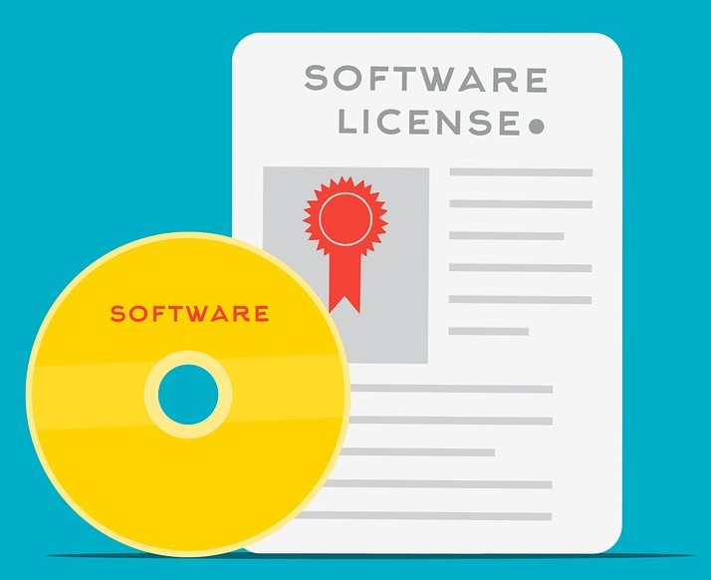
Project Schedule
Completed Tasks
Fleet Policy Update
Pool Vehicle Program
Vehicle Reconciliation
Implemented
Software

Slide 3
Project Schedule
Active Tasks
Training
Rollout

Slide 4
Maintenance Reminders
Service Logs
Inspections

Slide 5
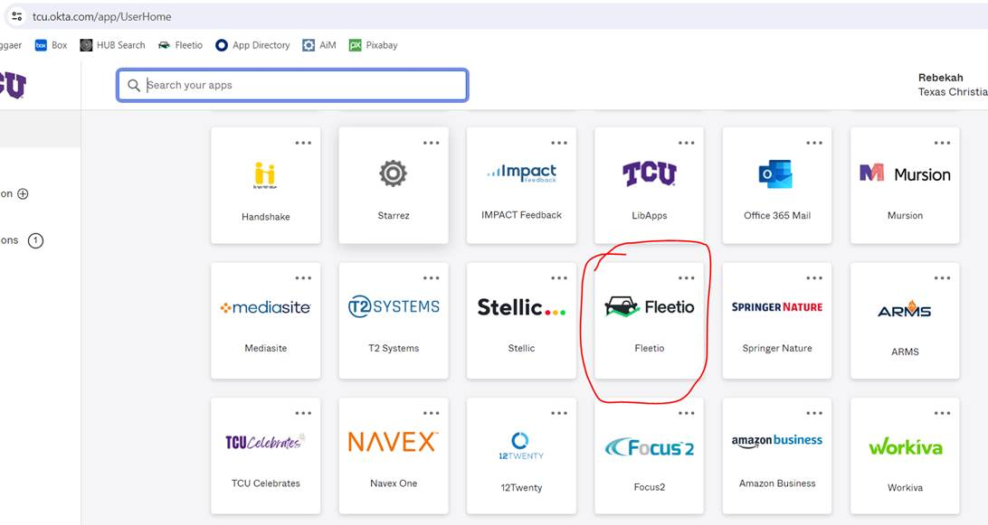
Where Can I Find Fleetio?
Visit tcu.okta.com. You should see a Fleetio tile like the one below.
5

Slide 6
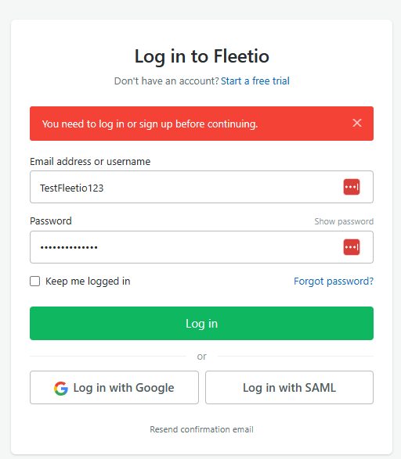
Log in with Single Sign On
6

Slide 7
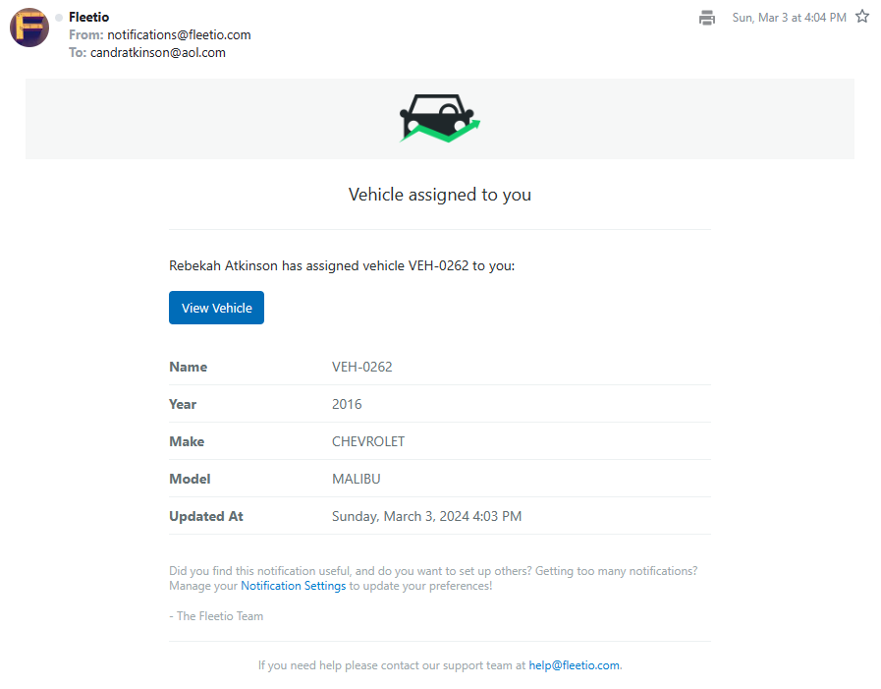
Vehicle Assignment
7

Slide 8
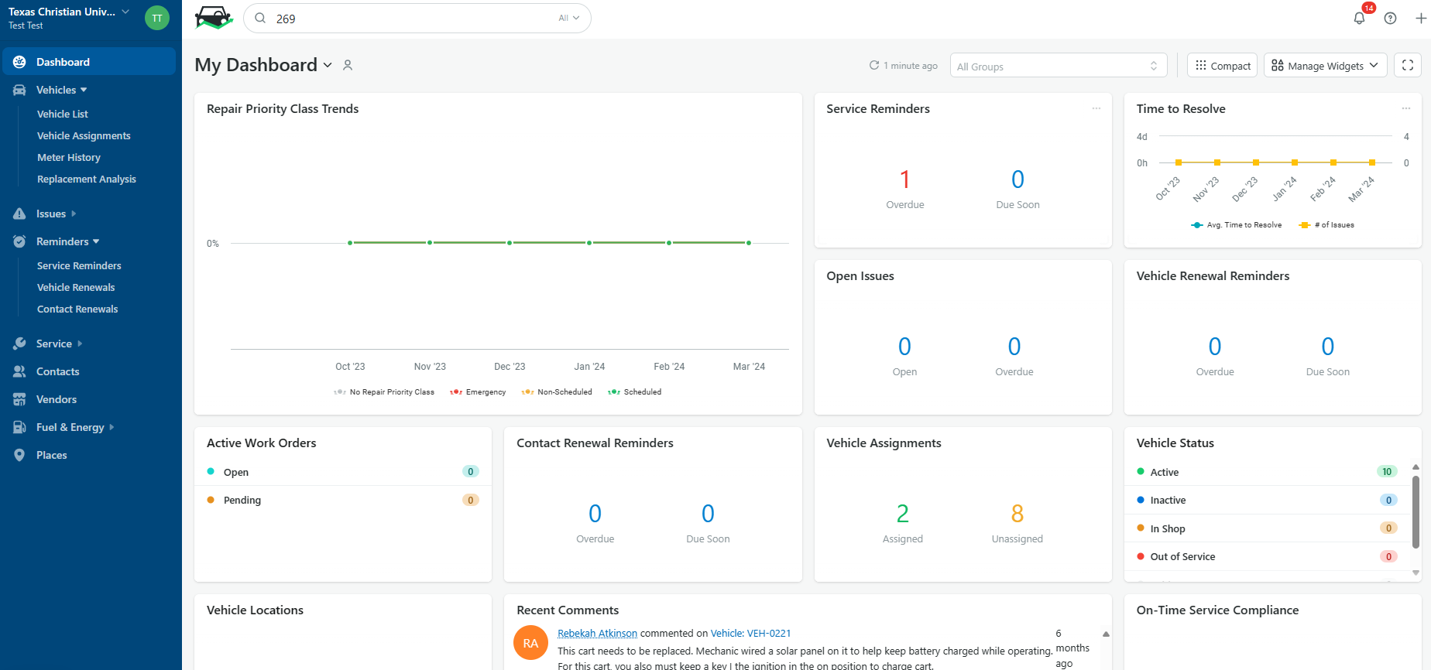
Exploring Your Dashboard

Slide 9
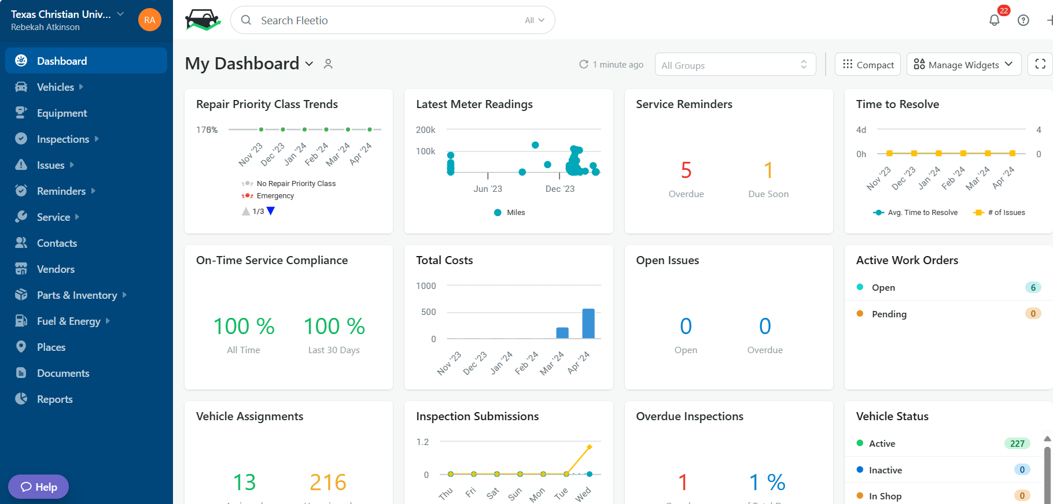
Adjust Your Widgets - Areas to Focus

Slide 10
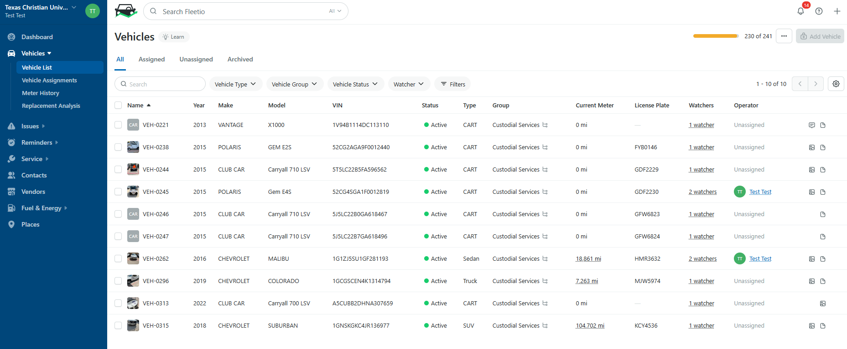
Use this Search
Not this One
Finding a Vehicle

Slide 11
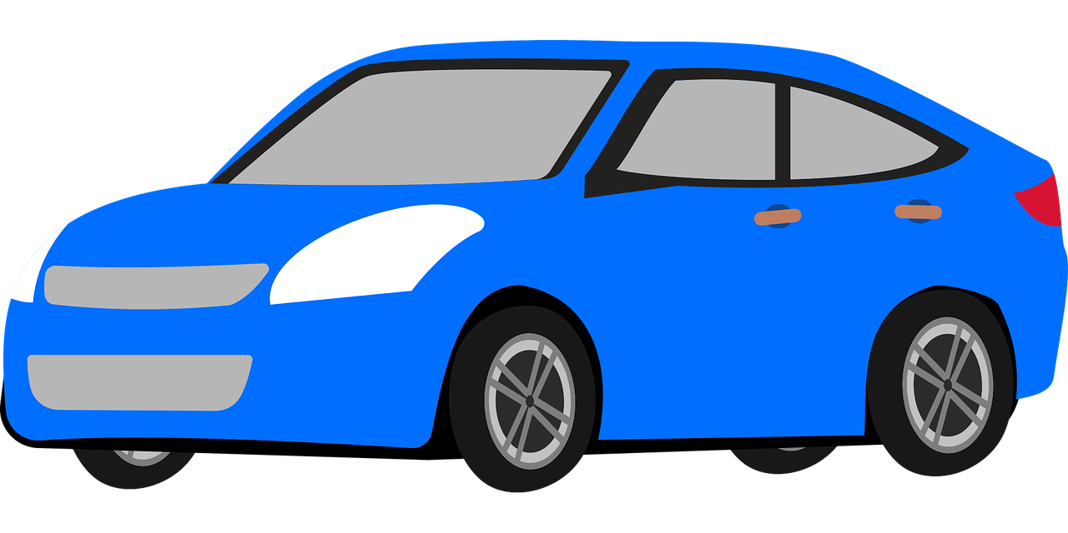
What do we need from you?
Scheduled Maintenance Services Reporting
Unscheduled Repair Services Reporting
Inspection Reporting

Slide 12
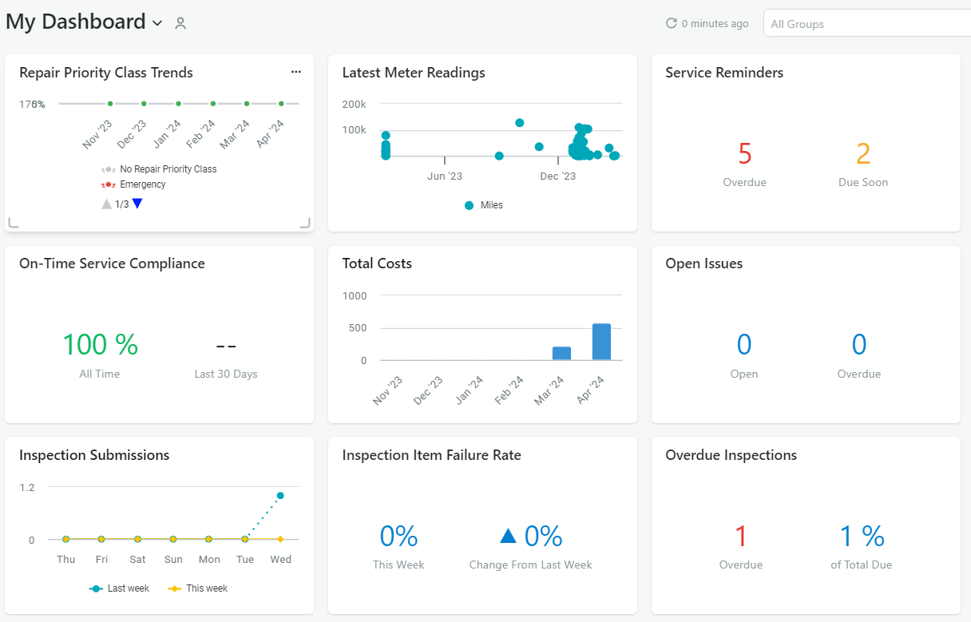
Scheduled Service Reporting
Step 1) Identify Maintenance Service Need
Step 2) Complete Maintenance
Step 3) See “Service Entry - Scheduled Service” for Reporting
Instructions
https://tcu.box.com/s/ou9bvjsbjhkigfp54wfw279auhequurm

Slide 13
Unscheduled Service Reporting
Services unrelated to a maintenance schedule (ex: flat tire, broken windshield, etc.), follow a different set of instructions.
Step 1) Complete Maintenance
Step 2) See “Service Entry - Unscheduled Service” for Reporting Instructions
https://tcu.box.com/s/ou9bvjsbjhkigfp54wfw279auhequurm

Slide 14
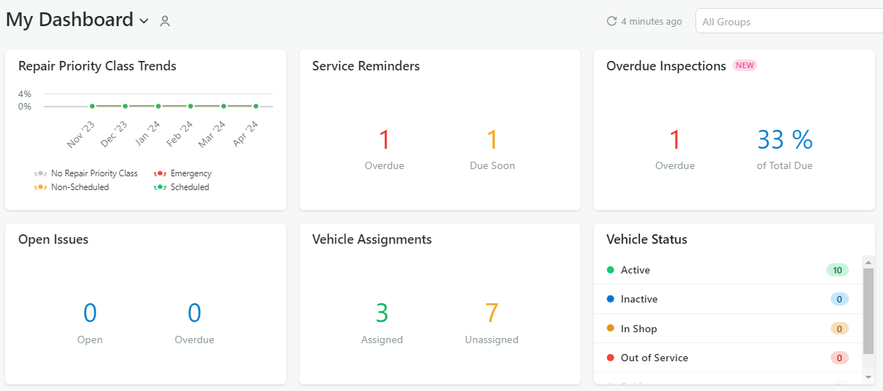
Inspection Reporting
Step 1) Identify Vehicle Needing Inspection
Step 2) See “Vehicle Inspection Report - Scheduled” for Reporting Instructions
https://tcu.box.com/s/ou9bvjsbjhkigfp54wfw279auhequurm

Slide 15
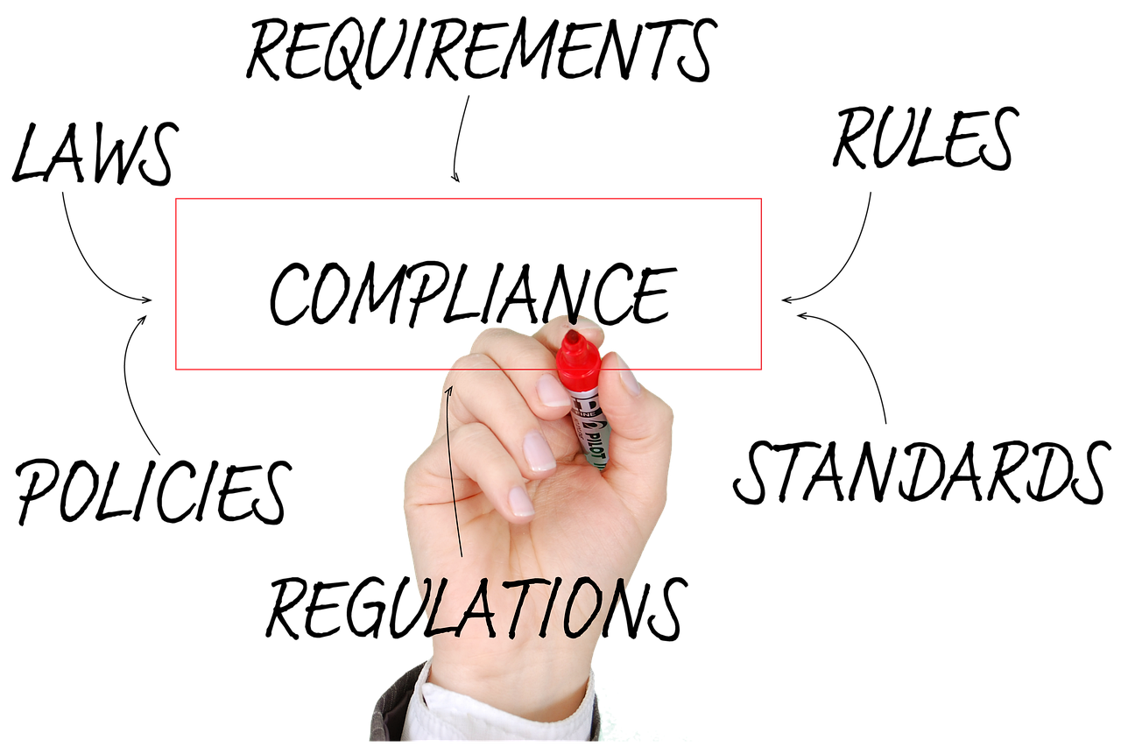
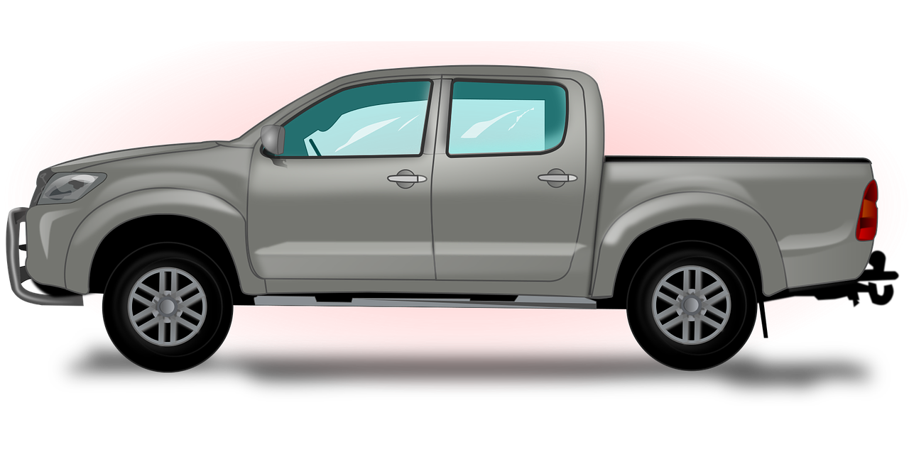
What’s in it for me?
Policy Compliance
Safety
Vehicle Replacement

Slide 16
Training Resources
Visit Box for Updated Training Resources:
https://tcu.box.com/s/ou9bvjsbjhkigfp54wfw279auhequurm

Slide 17
What can’t we do?
Add or Edit Vehicles
View Vehicles Outside Assigned Group
Create: Service Reminders, Service Programs, Contacts
Delete: Service Entries, Inspections, Meter Entries, Issues

Slide 18
I Have Questions!!
E-mail us at:
Fleet@tcu.edu

Slide 19
References
TCU Fleet Policy: http://tcusafety.tcu.edu/wp-content/uploads/2024/04/TCU-Fleet-Management-Guide-March-2024.pdf
Pool Vehicle Program: https://tcu.box.com/s/bz5rb3mzumfzwld4na1zk9g5jovvnz65
Fleetio Training Materials: https://tcu.box.com/s/ou9bvjsbjhkigfp54wfw279auhequurm
Fleetio Help Center: https://help.fleetio.com/s/

Slide 20
THANK YOU

