Slide 1
FLEET PROGRAM CHANGES

Slide 2
Introductions
Fleet Team
Fleet Manager: Rebekah Atkinson
R.J.Atkinson@tcu.edu
Fleet Operations Specialist: Ethan Long
Ethan.G.Long@tcu.edu
Graduate Student (Temporary): Regan Large
Regan.Large@tcu.edu

Slide 3
Project Schedule
Completed Tasks
Fleet Policy Update
Pool Vehicle Program Improvements
Implemented
Software

Slide 4
Project Schedule
Active Tasks
Vehicle Reconciliation
Rollout
Training

Slide 5
Use of the Fleetio software is MANDATORY for all TCU Fleet vehicle managers

Slide 6
Pro Tip:
Identify a Super User

Slide 7
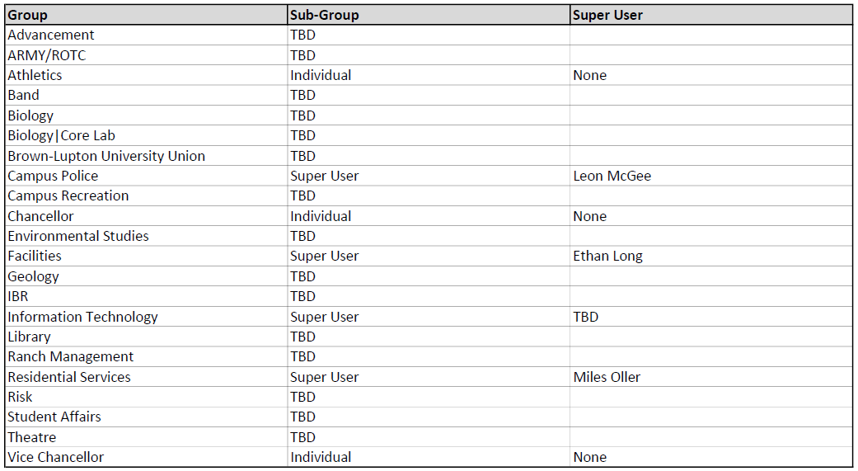
Does my Department have a Super User?

Slide 8
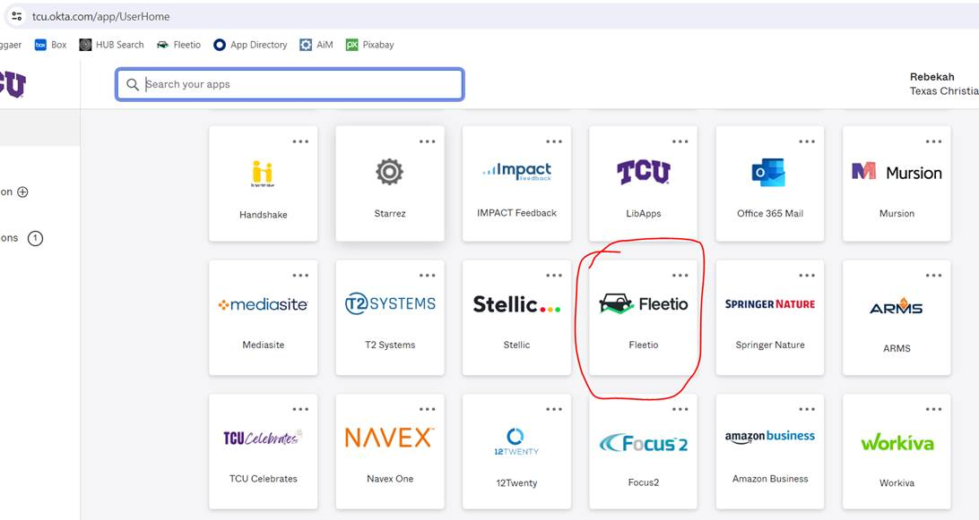
Where Can I Find Fleetio?
Visit tcu.okta.com. You should see a Fleetio tile like the one below.
8

Slide 9
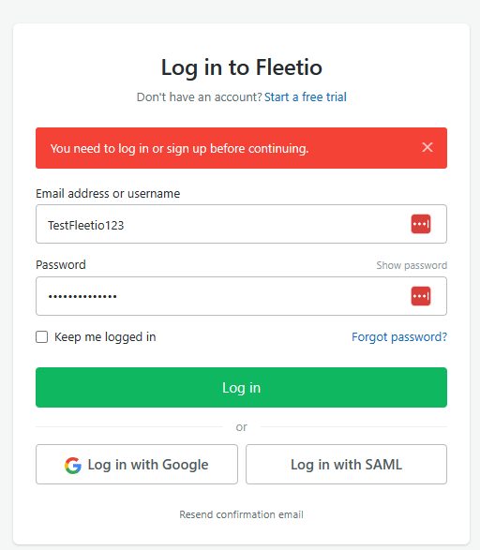
Log in with Single Sign On
9

Slide 10
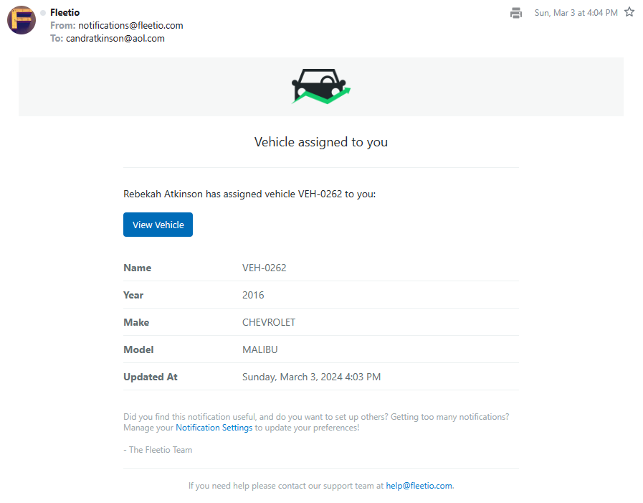
Vehicle Assignment
10

Slide 11
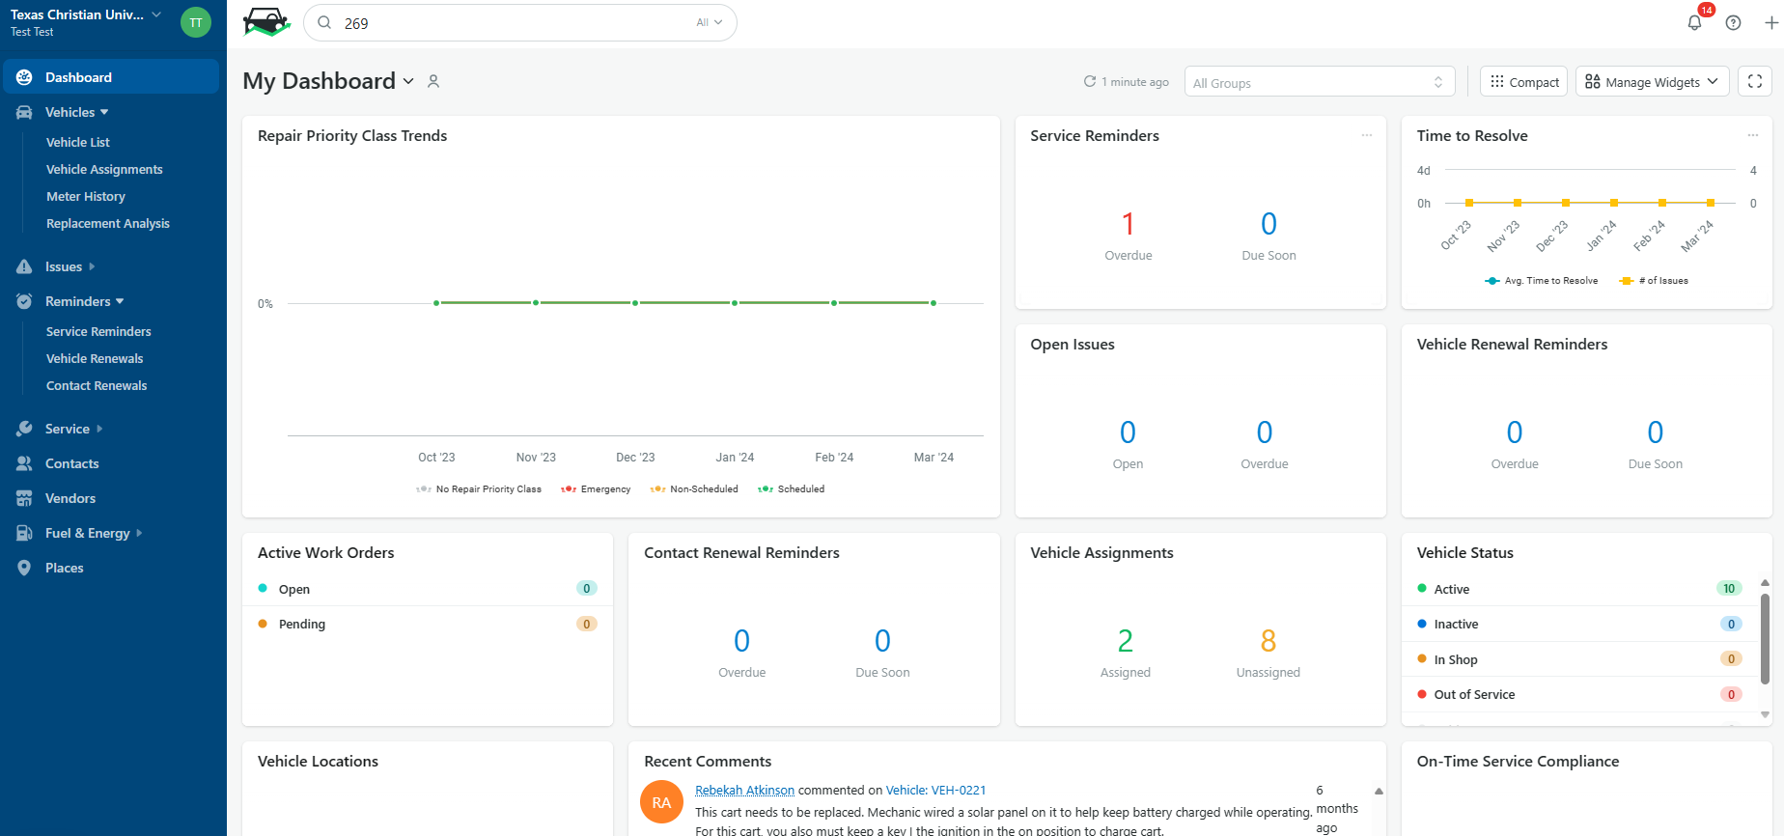
Exploring Your Dashboard

Slide 12
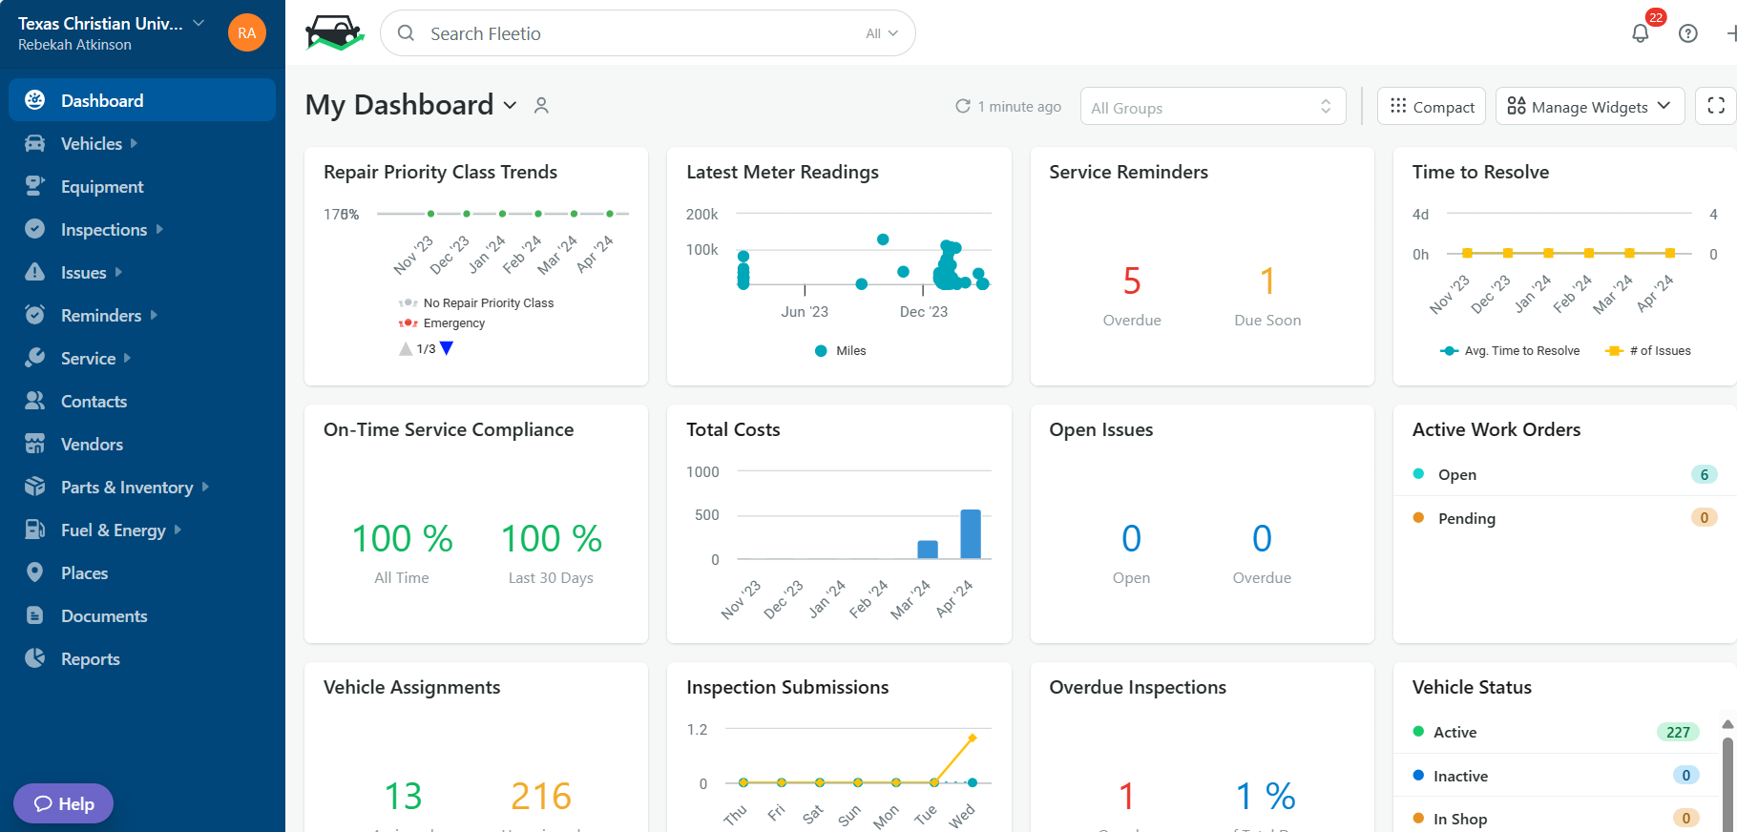
Adjust Your Widgets - Areas to Focus

Slide 13
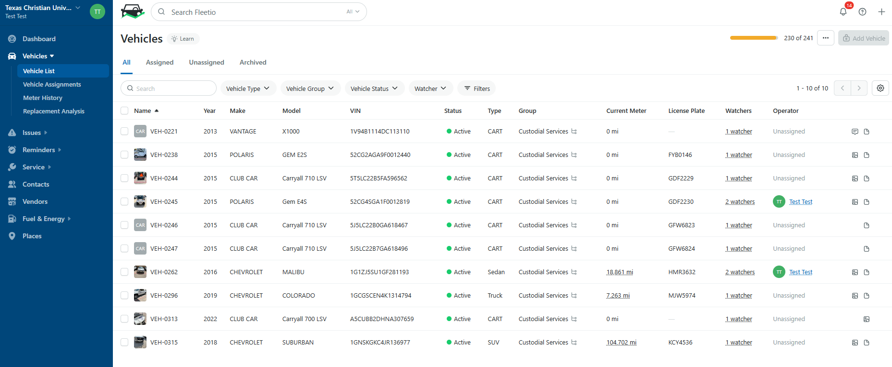
Use this Search
Not this One
Finding a Vehicle

Slide 14
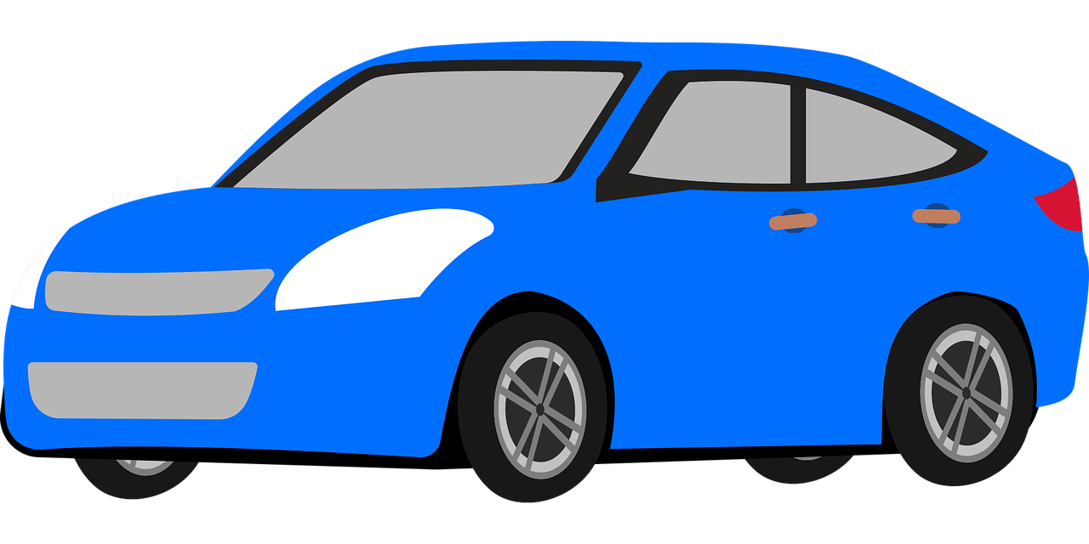
What do we need from you?
Scheduled Maintenance Services Reporting
Unscheduled Repair Services Reporting
Inspection Reporting

Slide 15
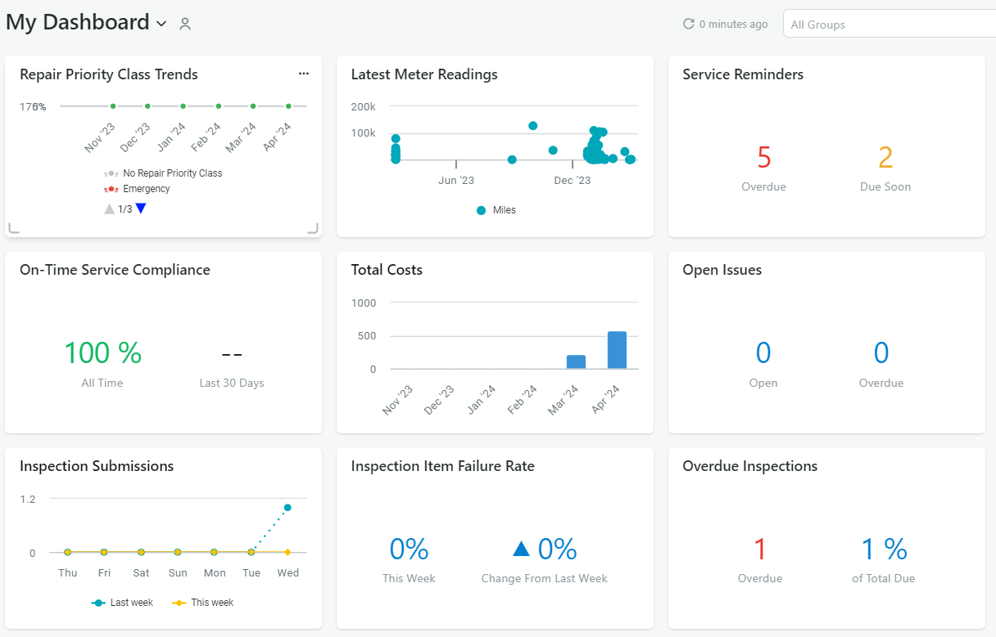
Scheduled Service Reporting
Step 1) Identify Maintenance Service Need
Step 2) Complete Maintenance
Step 3) See “Service Entry - Scheduled Service” for Reporting
Instructions
https://tcu.box.com/s/8b2shadybh5she0n4dq3mo2dzxxgfq3h

Slide 16
Unscheduled Service Reporting
Services unrelated to a maintenance schedule (ex: flat tire, broken windshield, etc.), follow a different set of instructions.
Step 1) Complete Service
Step 2) See “Service Entry - Unscheduled Service” for Reporting Instructions
https://tcu.box.com/s/8b2shadybh5she0n4dq3mo2dzxxgfq3h

Slide 17
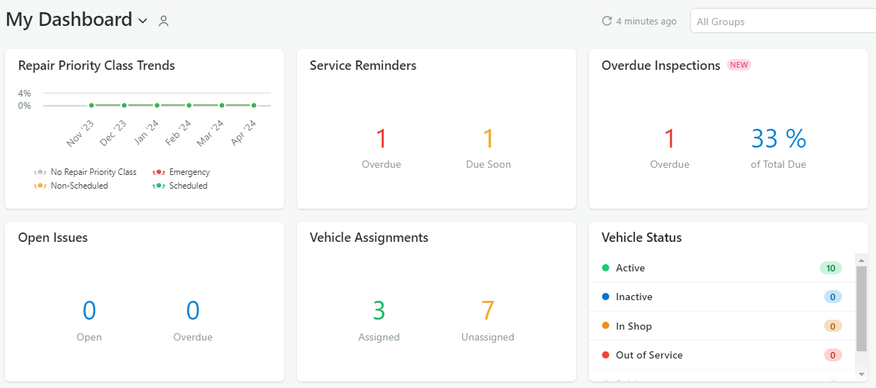
Inspection Reporting
Step 1) Identify Vehicle Needing Inspection
Step 2) See “Vehicle Inspection Report - Scheduled” for Reporting Instructions
https://tcu.box.com/s/8b2shadybh5she0n4dq3mo2dzxxgfq3h

Slide 18
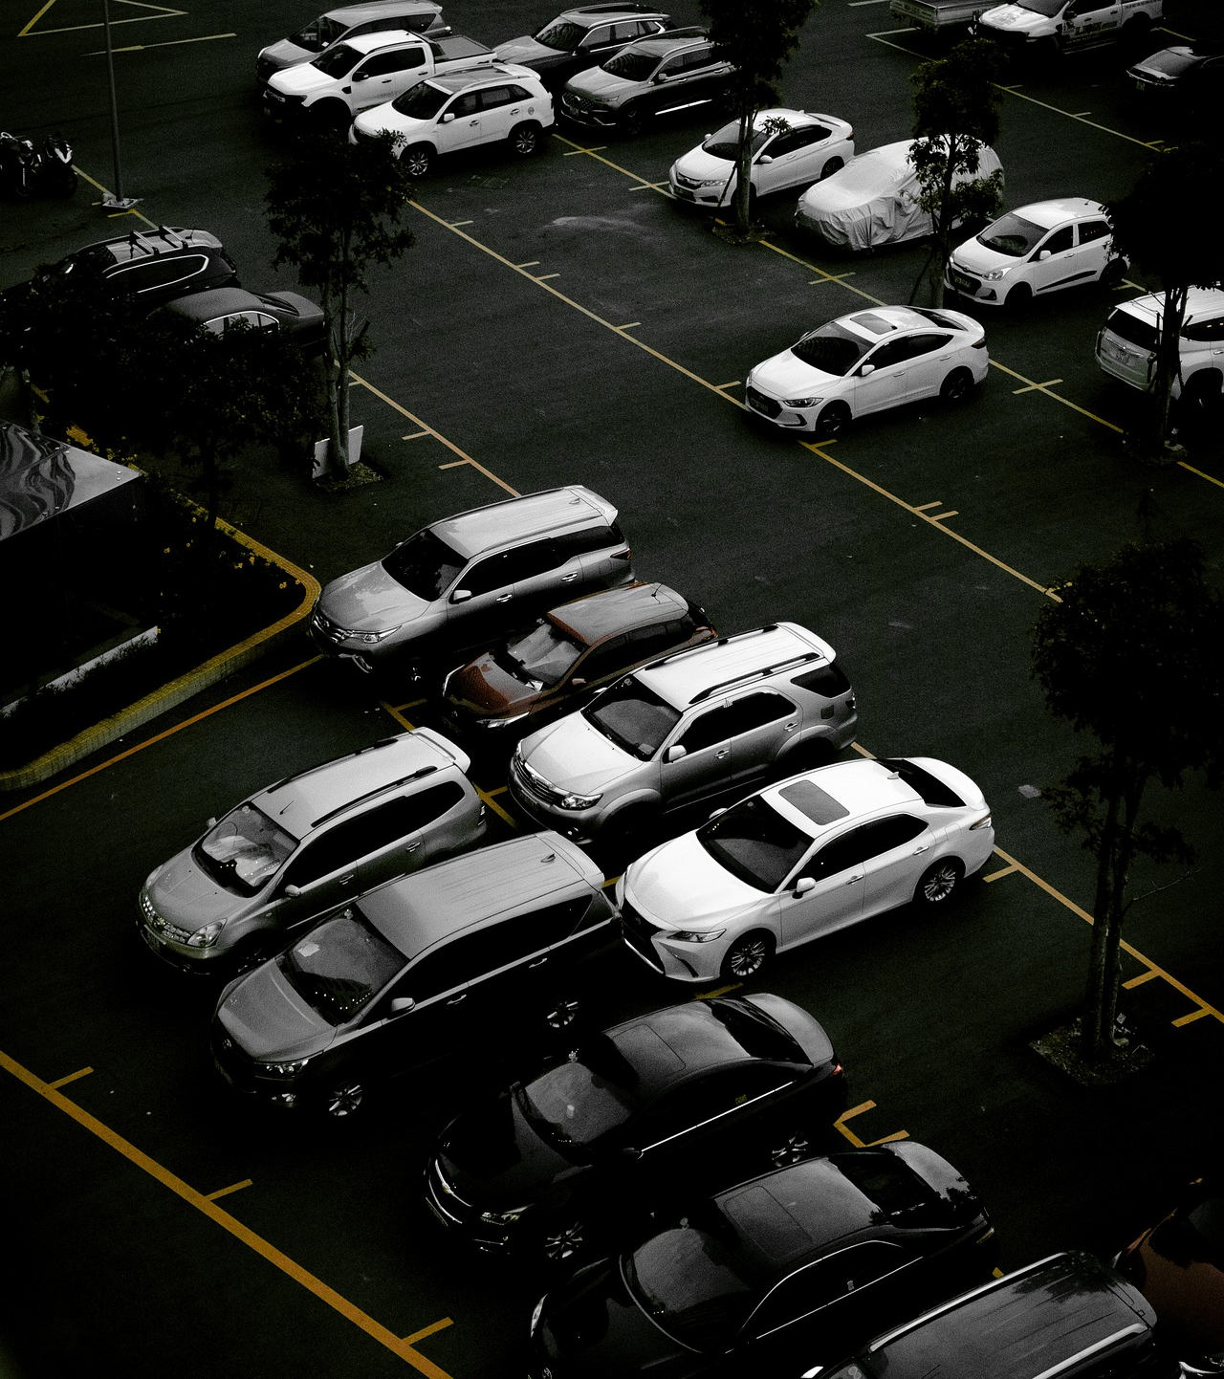
ISSUE Reporting & RESOLUTION
See “Creating and Issue and Resolving an Issue” for Instructions
https://tcu.box.com/s/ou9bvjsbjhkigfp54wfw279auhequurm

Slide 19
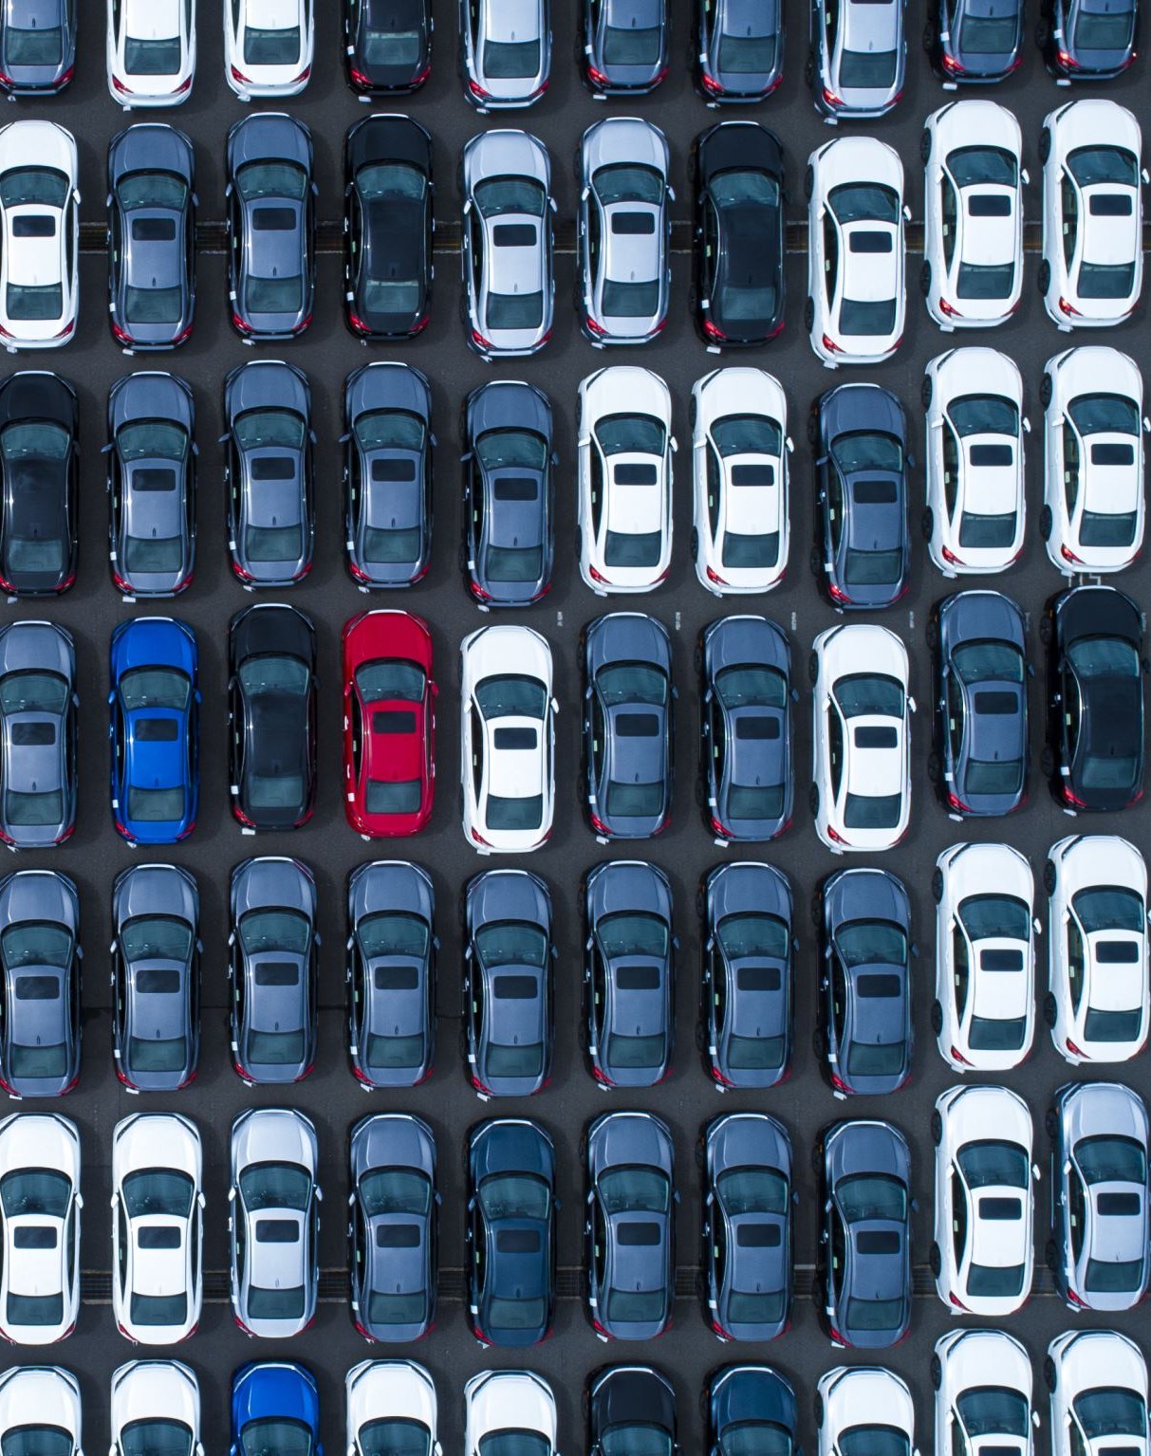
What can’t we do?
Add or Edit Vehicles
View Vehicles Outside Assigned Group
Create: Service Reminders, Service Programs, Contacts
Delete: Service Entries, Inspections, Meter Entries, Issues

Slide 20
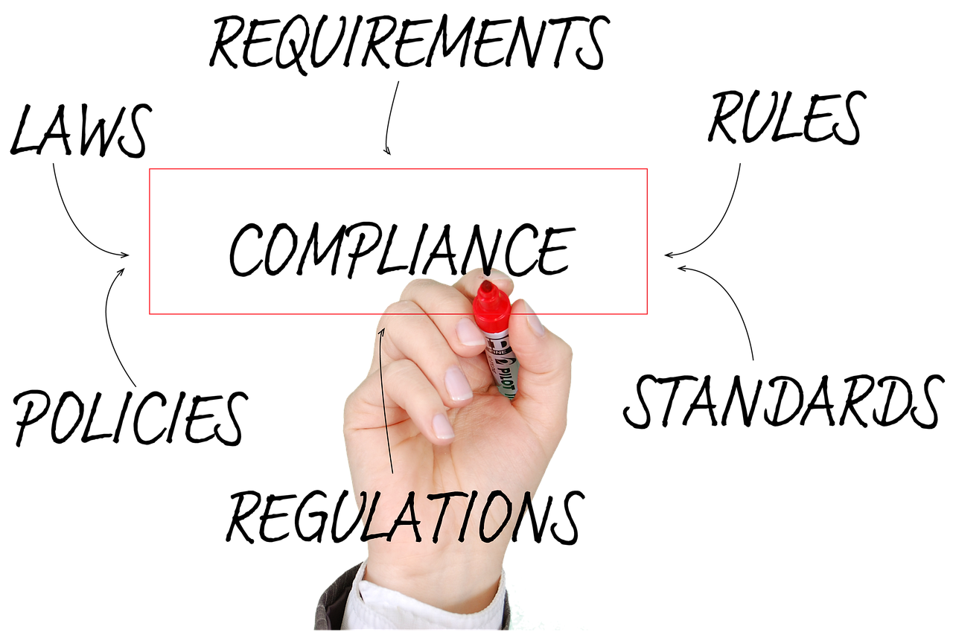
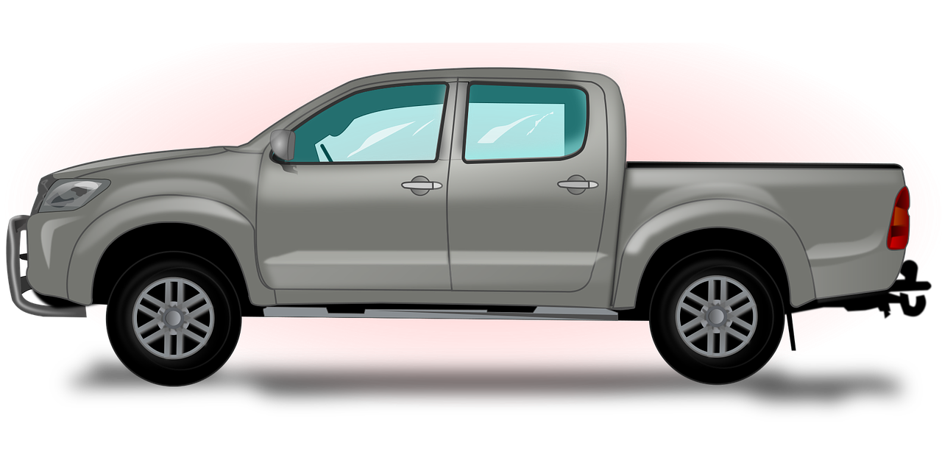
What’s in it for me?
Policy Compliance
Safety
Vehicle Replacement

Slide 21
Training Resources
Visit Box for Updated Training Resources:
https://tcu.box.com/s/ou9bvjsbjhkigfp54wfw279auhequurm
TCU FLEET PAGE COMING SOON!

Slide 22
Still Confused??
1:1 Training Available on Request

Slide 23
Next Steps
Fleet Reconciliation for Department Vehicles
Upload Service History
Wait for System Notifications

Slide 24
I Have Questions!!
E-mail us at:
Fleet@tcu.edu

Slide 25
References
TCU Fleet Policy: http://tcusafety.tcu.edu/wp-content/uploads/2024/04/TCU-Fleet-Management-Guide-March-2024.pdf
Pool Vehicle Program: https://tcu.box.com/s/bz5rb3mzumfzwld4na1zk9g5jovvnz65
Fleetio Training Materials: https://tcu.box.com/s/ou9bvjsbjhkigfp54wfw279auhequurm
Fleetio Help Center: https://help.fleetio.com/s/

Slide 26
THANK YOU

